Slide 1
BE WATER our friends!
EU Green Week
PARTNER EVENT
Huelva, Spain
6 June 2024

Slide 2
Water supply problems in Ukraine: impact of war
Yevhen Zubtsov, PhD, Professor,
Department of Chemical Engineering and Ecology
Inna Semenenko, Dr. Sci. Econ., Professor,
Department of Economics and Entrepreneurship
Volodymyr Dahl East Ukrainian National University

Slide 3
AVAILABLE WATER RESOURCES OF UKRAINE (EXCLUDING SEA WATER) Based on the data of Yakovlev V.V.
simultaneous volume, kм³
dynamic resources, million м³/DAY

Slide 4
KEY INDICATORS OF WATER RESOURCES USE AND PROTECTION (State Statistics Service of Ukraine)
Indicator | Year |  |  |  |  |  |  |  |  |  |  | Absolute deviation in 2021 from 2011, +/-
 | 2011 | 2012 | 2013 | 2014 | 2015 | 2016 | 2017 | 2018 | 2019 | 2020 | 2021
Water withdrawal from natural water bodies, million m³ | 14651 | 14651 | 13625 | 11505 | 9699 | 9685 | 9601 | 11296 | 11111 | 9952 | 8857 | -5794
Water usage, million m³ | 10086 | 10507 | 10092 | 8710 | 7125 | 7122 | 7103 | 6790 | 6821 | 6761 | 5649 | -4437
Total wastewater discharge, million m³, including: | 8044 | 8081 | 7722 | 6587 | 5581 | 5504 | 5493 | 5210 | 5374 | 5159 | 4685 | -3359
— polluted | 1612 | 1521 | 1717 | 923 | 875 | 871 | 867 | 952 | 737 | 518 | 542 | -1070
— normatively treated | 1763 | 1800 | 1477 | 1416 | 1389 | 1356 | 1321 | 1058 | 1188 | 1425 | 1430 | -333

Slide 5
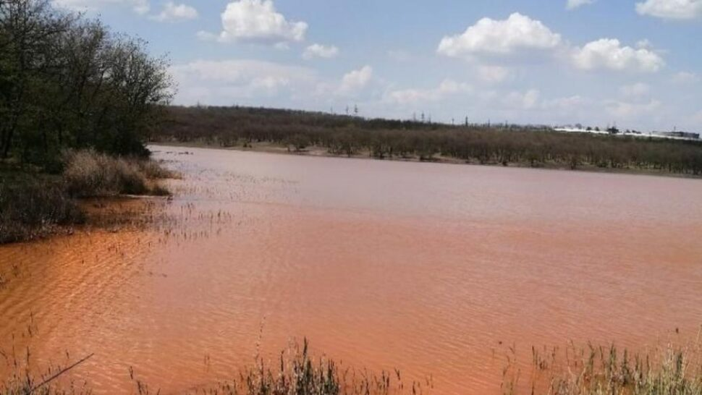
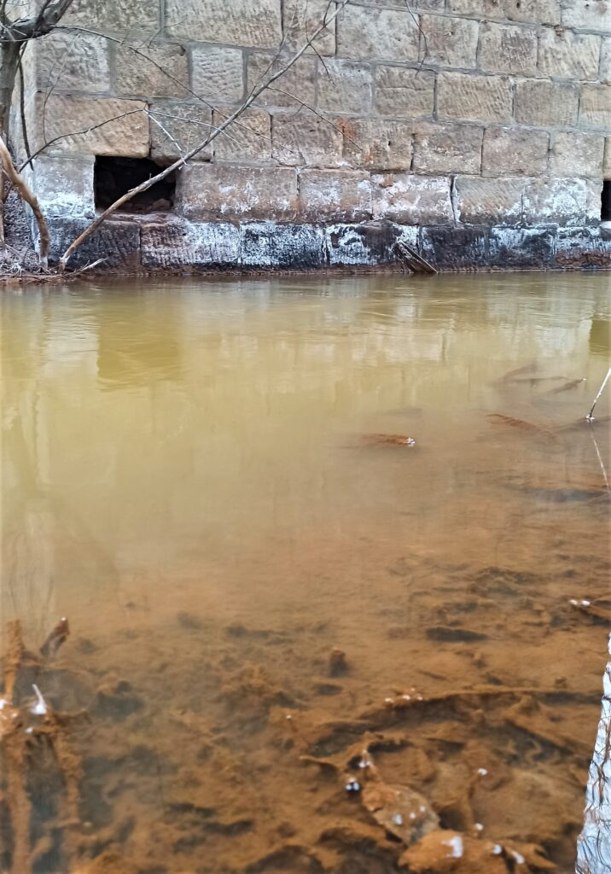
POND NEAR THE VILLAGE OF STANDARTNE AFTER DISCHARGE OF MINE WATER FROM THE MINE BULAVYNKA Photo from open sources
THE KOMYSHYVAKHA RIVER, TOWN OF ZOLOTE, LUHANSK OBLAST
Photo by Truth Hounds

Slide 6
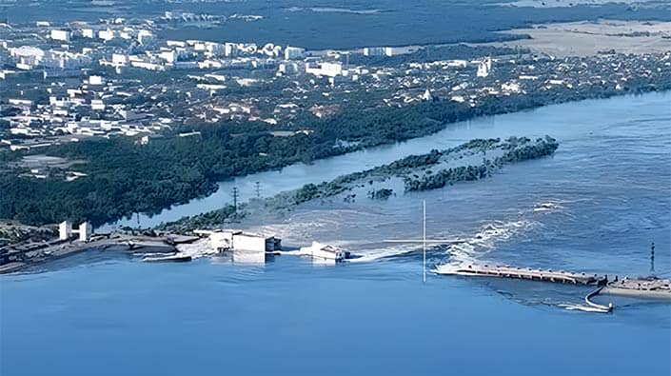
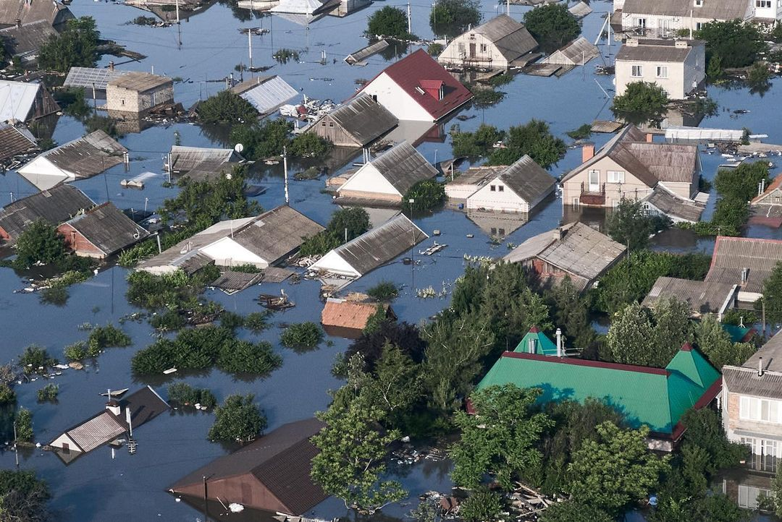
DEMOLITION OF THE KAKHOVKA DAM Photo from UP

Slide 7
THREATS TO DRINKING WATER SUPPLY IN AREAS OF EMERGENCY AND MILITARY OPERATIONS:
Spontaneous closure of mines;
Destruction of the dam and draining of the kakhovka water reservoir;
Destruction of water supply infrastructure;
Destruction of treatment facilities;
Mining, shelling and bombardment of the territory;
Large disorganized burials.
CONSEQUENCES:
Flooding or submersion of land surface by saline mine waters;
Chemical and radiation contamination of groundwater and surface water by mine waters and hazardous substances from waste dumps;
Contamination of water objects with organic and biogenic substances, increasing water toxicity;
Disruption of the water balance of the territory and exacerbation of water shortage.

Slide 8
RESERVES AND RESOURCES IN PROMISING DRINKING WATER SOURCES OF UKRAINE
Reservoirs and origins of the highest quality drinking water in Ukraine | Reserves and resources | Essential water treatment | Estimated service life at a rate of 10 liters/(person*day)
Fresh water in the collectors of the Dnipro-Donetsk artesian basin | 735 km³ | Partial removal of iron, fluoride, ammonia | 4,8 thousand years
Pre-industrial fresh and slightly brackish (up to 1.5 g/dm³ ) waters of the marl-chalk layer of the Dnieper-Donets Basin. | 75 km³ | Removal of ammonia, salts, trace elements, blending with purified atmospheric water | 490 years
Brackish waters of the slow water exchange zone with salinity up to 10 g/dm³ | 1600 km³ | Desalination by reverse osmosis or blending with treated atmospheric water | 10,4 thousand years
Total strategic reserves of pre-industrial water | 2410 km³ | All the required technologies have been explored to date | 15,7 thousand years
Relic water of Antarctic glaciers | 6,0 km³/ year | Blend with natural brackish water | Long-term
Groundwater of sandy river terraces | 1942 thousand m³/ day | Fluoridation and iodization, partial removal of ammonia and iron | Unlimited for 194 million people

Slide 9
MEASURES TO IMPROVE THE RELIABILITY OF WATER SUPPLY TO THE POPULATION IN AREAS OF EMERGENCY AND MILITARY OPERATIONS
Approval of the Rules for the use of drinking water during emergencies (natural demand is 3 liters per person) with an emphasis on rational consumption;
Organization of drinking water supply points, that are under military protection, during emergencies;
Increasing the availability of high quality drinking water for the population by arranging pump rooms based on artesian wells and springs;
Organizing water delivery by tanker trucks;
Providing the population with inexpensive water conditioning devices using natural materials;
Creating tactical stocks of drinking water in administrative centers in case of emergencies;
Use of backup technologies for water purification and disinfection (including without electricity usage) from backup sources;
Use of desalination units for brackish and mineralized water.

Slide 10
SPECIFIC MEASURES OF THE UKRAINIAN WATER STRATEGY
Separation of drinking and other water supplies;
Strategic reserves of ecologically clean fresh and brackish water in geological structures;
Improving and introducing regulatory criteria for physiological adequacy and environmental purity of drinking water;
Increasing the availability of high-quality drinking water to the population by arranging pump rooms based on artesian wells and springs, organizing water delivery by tanker trucks, and providing the population with inexpensive water conditioning devices using natural materials;
Creating tactical stocks of drinking water in administrative centers in case of emergencies;
Implementation of engineering methods to protect and improve the quality of spring and well water;
Preservation of groundwater reserves of drinking quality by arranging underground water intakes intended for domestic and technical water supply with replenishment from surface sources;
Initiating discussion by the international community of the use of high-quality fresh water reserves in Antarctica in order for Ukraine to gain access to the quota.

